Slide 1

Automating the Software Delivery Pipeline
<That> Edition
DevOps in the Real World
@gbworld

Slide 2

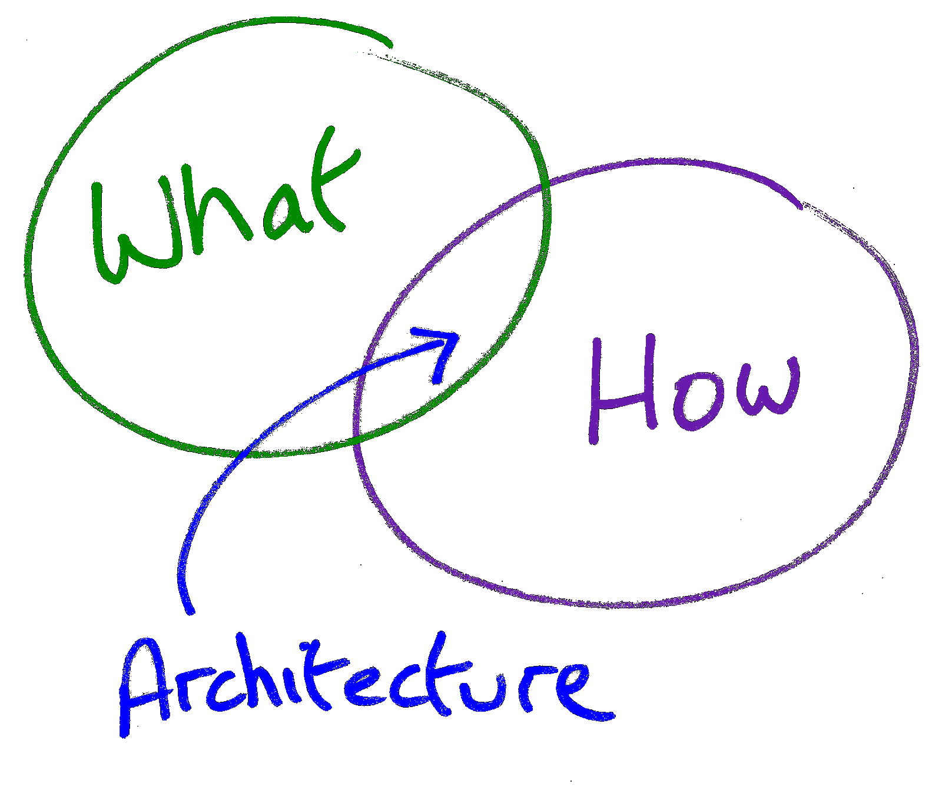


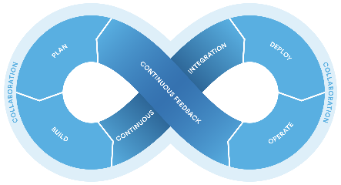
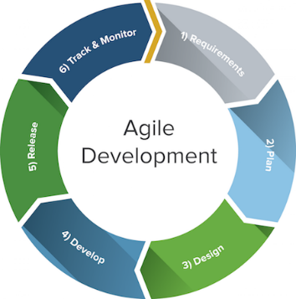
Who?
Senior Architect
Gregory A. Beamer
Focus: Enterprise Strategy
μ
μ
μ
DevOps
Microservices
Continuous …
Integration
Delivery/Deployment
Inspection
Quality
Feedback
Build
Test
Automate
Provision
Release
Agility
Monitor

Slide 3
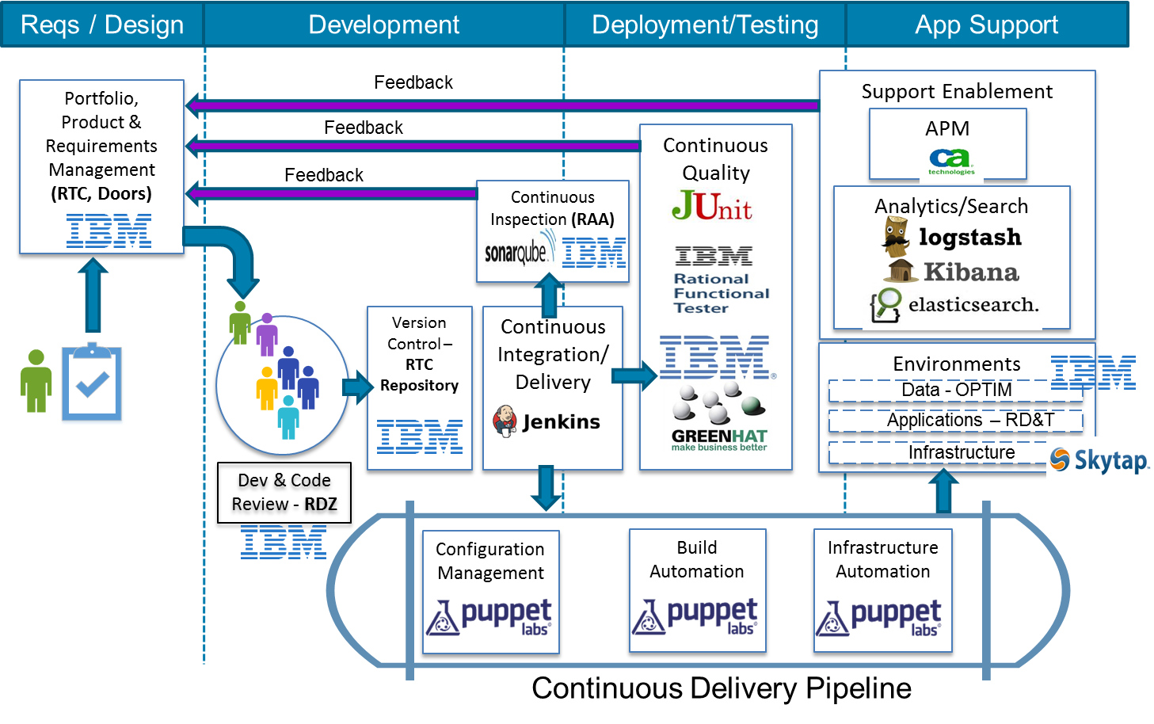

Slide 4

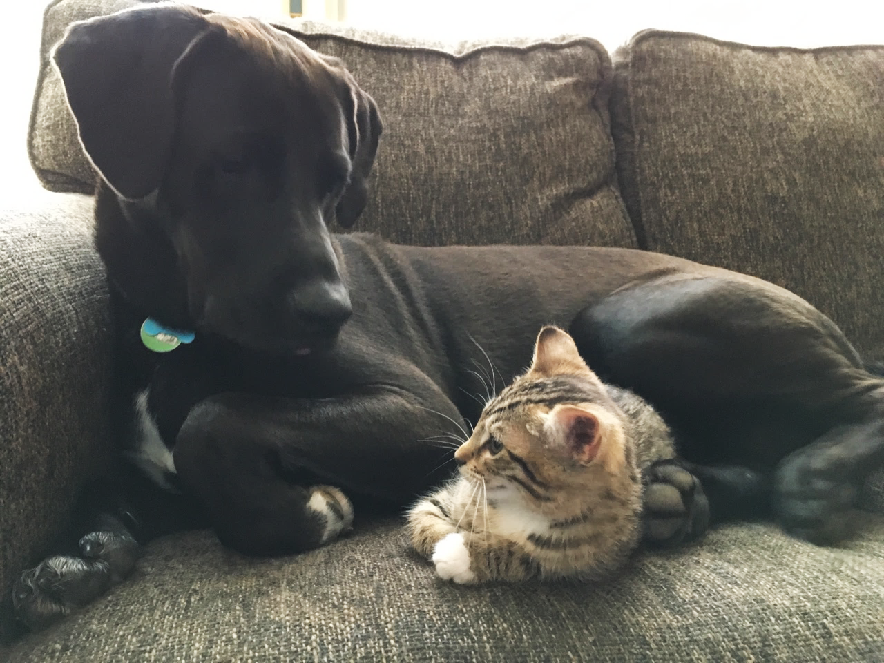
And World Peace!

Slide 5
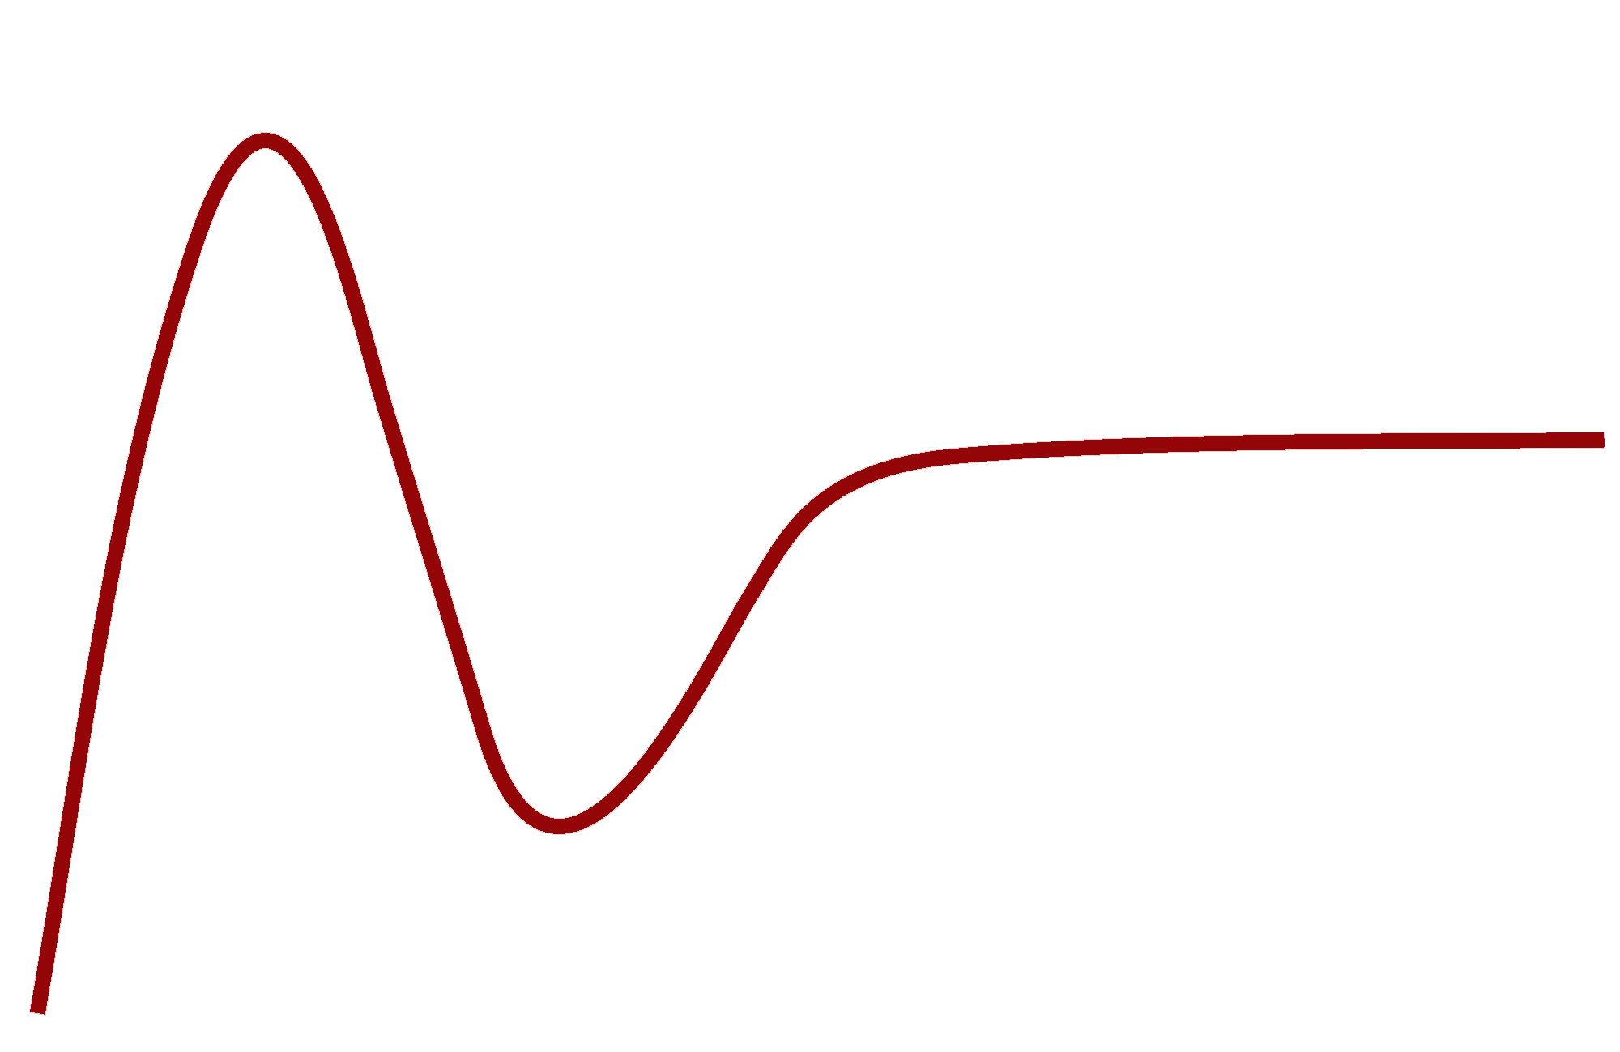

What?
Peak of Inflated Expectations
Microservices
Silver Bullet
or Hot Air?
DevOps
Plateau of Productivity
Visibility
Slope of Enlightenment
Trough of Disillusionment
Technology Trigger
Time
Notes:
This is the standard Gartner Hype Curve on new technologies. Microservices are at the top of the roller coaster and we are about to take the long ride to the bottom.

Slide 6
DevOps
What is the difference between the following???
Continuous Integration
Continuous Deployment
Continuous Delivery
A Quick Question

Slide 7
DevOps
When you integrate, do you …
Deploy?
Deliver?
When you Deploy, do you …
Integrate?
Deliver?
When you Deliver, do you …
Integrate
Deploy?
A Quick Question

Slide 8

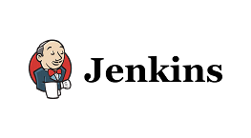
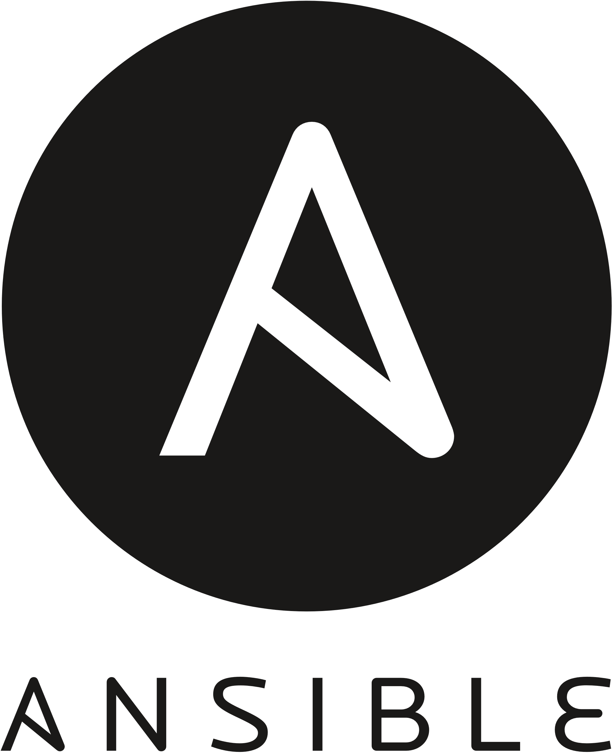
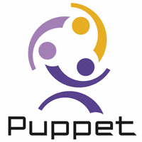
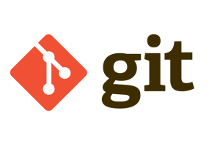
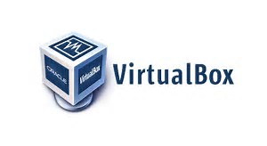

DevOps
A Quick Question
Continuous Integration
Continuous Deployment
Continuous Delivery
Dev Machine
Development
Test
Staging
Production

Slide 9

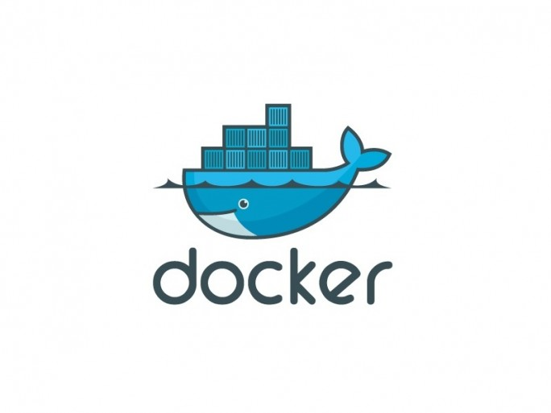
DevOps
Dev Machine
Development
Test
Staging
Production
A Quick Question
Continuous Integration
Continuous Deployment
Continuous Delivery

Slide 10
Being Practical
One type of deployment versus many
Ideal is 1
Practical in many environments is 2
Technology Focus
Containerization
Virtualization
Metal
Cloud*
SaaS
Virtuals
Containers
Deployment Strategy
Install
Build and Deploy
Imaging/Containerizing
Incremental Change
Deployment Methodology

Slide 11
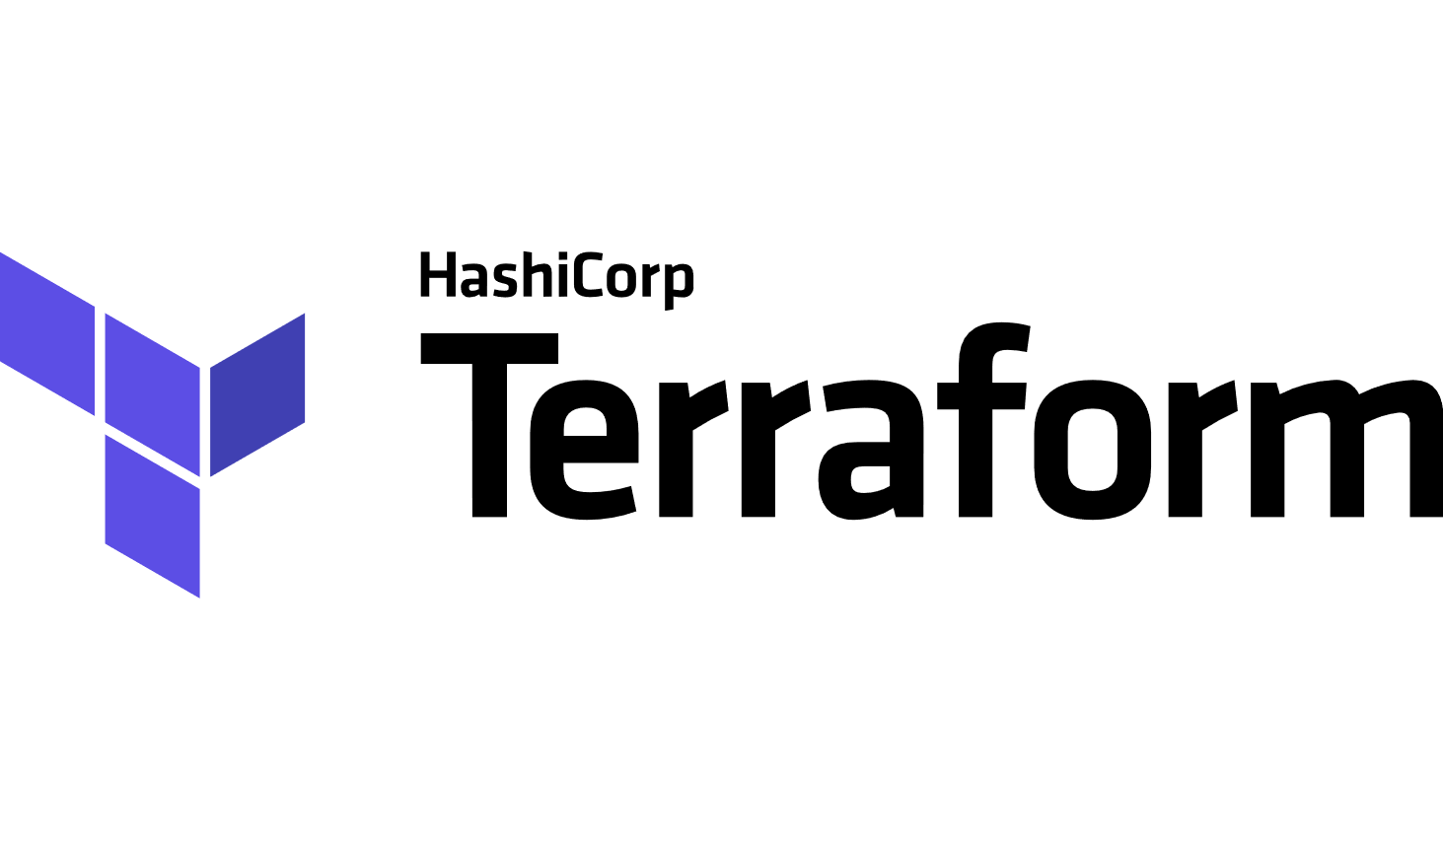

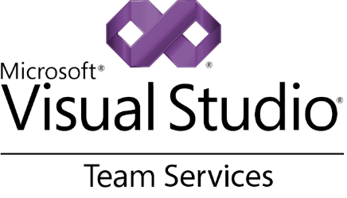



Being Practical
Tools and Technology

Slide 12
Being Practical
What solves the job?
Ideally, what BEST solves the job
What is already employed?
What skills your team has?
What works across the maximum number of environments?
Consolidation
Reduced landscape
Learning
Support
Tools & Technology

Slide 13
Being Practical
Microsoft Team Services – All in one solution
Atlassian (Jira, BitBucket, Bamboo, etc.) – Suite of complementary products
Open Source – Cafeteria Style
Tools & Technologies

Slide 14
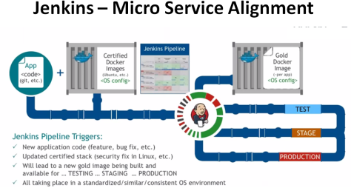
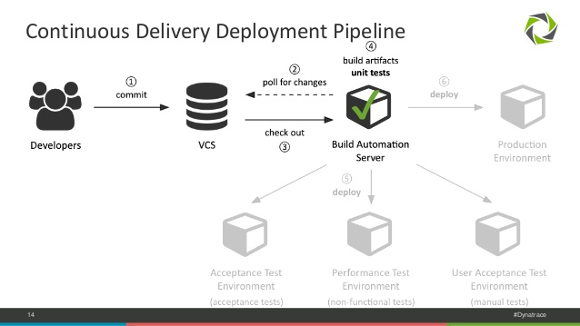


Slide 15
Preparation
FILEZ
tinyurl.com/AutomatingThePipeline
https://github.com/gbworld/Automating-The-Software-Delivery-Pipeline

Slide 16
 |  | Local | Network
Area | Concern | Developer Machine | Dev | Test | Staging | Production
Develop | IDE
Develop | Tool(s)
Build | Technology
Build | Strategy
Provision | Hardware
Provision | Software
Deploy | Strategy
Deploy | Tool(s)
Deploy | Orchestration
Configure | Tool(s)
Quality/Test | Test: Unit
Quality/Test | Test: Integration
Quality/Test | Test: Acceptance
Quality/Test | Test: Performance
Quality/Test | Test: Load
Quality/Test | Code Analysis: Static
Quality/Test | Code Analysis: Security
Release | Tool(s)
Monitoring | Log Analysis
Monitoring | APM

Slide 18
Demo
Frameworking Your Pipeline

Slide 20



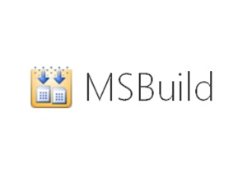





Example of a Typical Pipeline Today

Slide 21
High Functioning DevOps Groups

Slide 22
Ideal Implementation

Slide 23
How?
CASA Development Model
Core AS Application
Test Driven/
Test Early Approach
TDD
BDD
Organize Your Code
ATDD
Adapter-based
Boundaries
TESTS
ADAPTER
ADAPTER
CORE
CONTRACT
CONTRACT
ADAPTER
ADAPTER
Contract First Development
DOMAIN
Domain Driven Design
Notes:
This is my development model. I created it as Core AS Application in 2010. I created CASA as a name in 2016 due to not having a cute name. It has nothing to do with a Mexican house, although I could make up some really good BS to explain why it is CASA. But, then, Scrum, as a word, does not really apply to Agile, except perhaps when Scrum teams get in a tight circle and punch each other in the face. As a rule, I tend to avoid these shops.
The idea is the Core is the Application and you should be able to change out persistent mechanisms (where you store state between sessions) and experience layers (UI, for example, but a service is a means of interaction – not human, but machine).
Core is where the business logic goes.
Domain models go at the bottom of the core. NOTE: you can create models on the experience “layer” as well; this is what MVC (and MVVM, etc) do. This works with Domain Driven Design (ddd), although I separate behavior (in the core) from state objects (domain models). The models the gird up Core should be behavior-less, at least as the rule, and business focused. The sides are contracts to abstract out the core from persistence and experience. Think interfaces in most languages. These contracts allow you to change implementation at any time. Designing the contracts up front is the safest manner (Contract First Development). NOTE: I adhere to consumer driven contracts, which means the people using my microservices will tell me what I need. I do not design microservices on top of data, as that creates CRUDdy services. Adapters help you connecting to different persistent and experience projects.
At the top are tests. I have a few buzzwords to make this slide look really cool, but covering your code properly is more critical than writing all of your tests prior to coding. I am an advocate of XDD (TDD, BDD, etc.) types of styles, as they help you design up front, but much of this can be facilitated with contract first approaches even if you do not use XDD (NOTE: Since TDD can be acceptance driven, ATDD is a BS word).

Slide 24
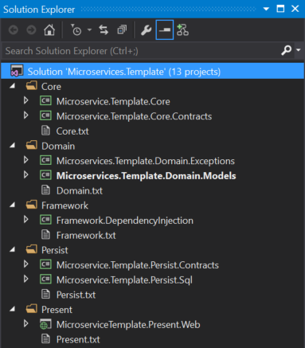
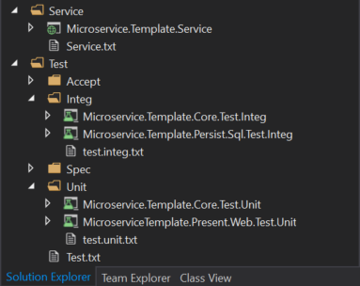
Notes:
This slide shows that I can really do this in the real world. Here is my method of filling this in. This is essentially Onion Architecture, although I do not keep the domain behavior (Core project) completely inverted. I will share the project once I get a chance. Subscribe to @gbworld on Twitter for upcoming details.
Start with the green arrow and design the dumb domain models (dumb meaning they hold state, but have no behavior) – Every other project will use this one
Bonus – start developing exceptions used in the application and store here NOTE: Sometimes exceptions can become more global and end up as a reference
Don’t test getters and setters (at least not in most cases). If Microsoft (or Oracle) forget how to get and set, you will have a much bigger problem testing will not solve. It is a waste of time to test state only objects. If you do add code to aggregate or calculate (private set; public get?), then you might want to test.
Fill in the contract projects at every level.
You can now do in any order, but I will generally start on my repository to fill the domain models and then go to core to build up behavior. I will use a Test driven approach to test these.
I then move to Services and/or Present (for Presentation – need to update slide), depending on application type. I used to keep services in the Presentation folder, but found that confused people who could only envision things users dinked with (UI) as Presentation. In reality, you are presenting in services, although it is just data and it is designed for computers to understand, not people.
My test folder is organized in this way:
Accept are acceptance tests that are pure acceptance. Things like Fitnesse tests go here
Integ are Integration tests. They look exactly like Unit tests, but use the actual objects instead of mocks, fakes or stubs. If state changes, I will set up some data and/or revert changes after the test runs. This is so I don’t influence other tests. One test (or test class?) should never influence another test; they should be able to be independently run. If you have a string of tests that have to run in a particular order, you should set up the data changes from the first test in the second test rather than count on tests running in a particular order (NOTE: Some test frameworks allow this insanity, but better not to rely on it)
Spec is for Specification – This is SpecFlow for me, but could be other Behavior tests using a jspecification language to describe them (like SpecFlow)
Unit should be obvious. Use the contracts to mock out dependencies (or stub or fake).

Slide 25

How?
Hexagonal
Architecture
Organize Your Code
Clean
Architecture
Notes:
Here is my Core blue circle over Alistair Cockburn’s Hexagonal Architecture. Someone now calls this “Clean” Architecture, which means I want to slap him. I hate using superior sounding words for anything, as we will likely find an even better architecture in the future. Here is the progression:
Clean Architecture
Cleaner Architecture
Cleanest Architecture
We need another damned word meaning cleaner than cleanest architecture
My advice: Don’t do drugs. Hexagonal describes this better, let’s not use our bias to pontificate. Of my pony pedestal of pontification now.

Slide 26
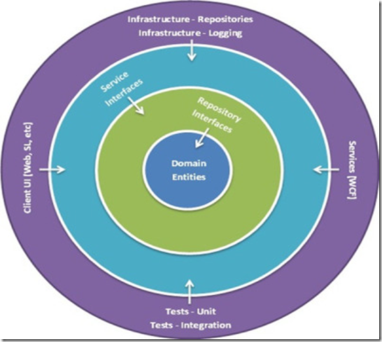
How?
Organize Your Code
Notes:
This is the same architecture looking like a Willy Wonka Everlasting Gobstopper. It is called Onion Architecture, cause architecture’s got layers. But parfaits have layers too, although Ogre’s aren’t like Parfaits. I hope you get the reference. If not, there is the obscure tool called Google.

Slide 27
How?
CASA Development Model
Core AS Application
Test Driven/
Test Early Approach
TDD
BDD
Organize Your Code
ATDD
Adapter-based
Boundaries
TESTS
ADAPTER
ADAPTER
CORE
CONTRACT
CONTRACT
ADAPTER
ADAPTER
Contract First Development
DOMAIN
Domain Driven Design
Notes:
A double dip of my architecture, which is pretty much the same thing showing how you map some best practices into the whole thing. Nice, huh? NOTE: I developed this before some of the other models. Not stating anyone stole it, but rather than we independently realized the same idea, making an implied consensus amongst some architects. ALSO NOTE: There was once a consensus the world was flat, so don’t see this as a silver bullet. It works wonderfully now, but paradigms change over time.

Slide 29
Last Minute Stuff
Four Letter Words
Plan
Docs
Reqs
Best Practices
Other Thoughts
Other Topics

Slide 30
Automating the Software Delivery Pipeline
<That> Edition
DevOps in the Real World
@gbworld

